Slide 1




THYNK UNLIMITED
Home
About
Content
Others
DATA STRUCTURES AND ALGORITHMS

Slide 2
THYNK UNLIMITED
Home
About
Content
Others
A memory stack is a data structure that operates on the Last In, First Out (LIFO) principle, meaning that the last element added to the stack is the first one to be removed.
DETERMINE THE OPERATIONS OF A MEMORY STACK AND HOW IT IS USED TO IMPLEMENT FUNCTION CALLS IN A COMPUTER.

Slide 3
THYNK UNLIMITED
Home
About
Content
Others
DEFINING A MEMORY STACK
STRUCTURE
RETURN ADDRESS
LOCAL VARIABLES
PARAMETERS
The address to return to after the function completes.
Variables that are defined within the function.
Arguments passed to the function.

Slide 4
THYNK UNLIMITED
Home
About
Content
Others
DEFINING A MEMORY STACK
STRUCTURE
PUSH
POP:
PEEK (TOP):
Add a new frame to the top of the stack.
Remove the top frame from the stack.
View the data in the top frame without removing it.

Slide 5
THYNK UNLIMITED
Home
About
Content
Others
DEFINING A MEMORY STACK
STRUCTURE
ISEMPTY:
Check if the stack is empty.

Slide 6
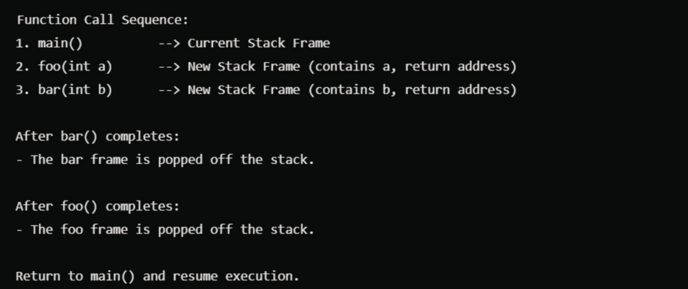
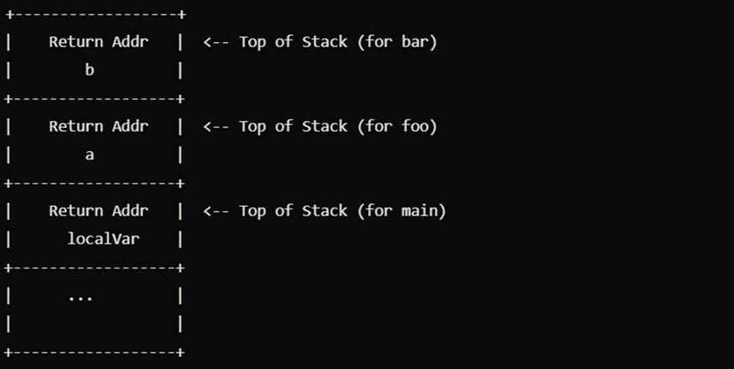
THYNK UNLIMITED
Home
About
Content
Others
STRUCTURE
Control is transferred back to the return address saved on the stack.
Demonstrating Stack Frames
Here’s a simple illustration of stack frames during function calls:

Slide 7
THYNK UNLIMITED
Home
About
Content
Others
IMPORTANCE OF THE MEMORY STACK
Automatic Memory Management:
The stack automatically allocates and deallocates memory for function calls and local variables, which simplifies memory management.

Slide 8
THYNK UNLIMITED
Home
About
Content
Others
FIFO QUEUE OVERVIEW
FIFO (First In, First Out) is a type of data structure where the first element added to the queue will be the first one to be removed

Slide 9
THYNK UNLIMITED
Home
About
Content
Others
DEFINE
THE STRUCTURE
A FIFO queue typically consists of two main operations:
Enqueue: Adding an element to the rear of the queue.
Dequeue: Removing an element from the front of the queue.

Slide 10
THYNK UNLIMITED
Home
About
Content
Others
ARRAY-BASED
IMPLEMENTATION
In an array-based implementation, the queue uses a fixed-size array to store elements. We maintain two pointers (or indices): one for the front and one for the rear of the queue.
Structure Definition:

Slide 11
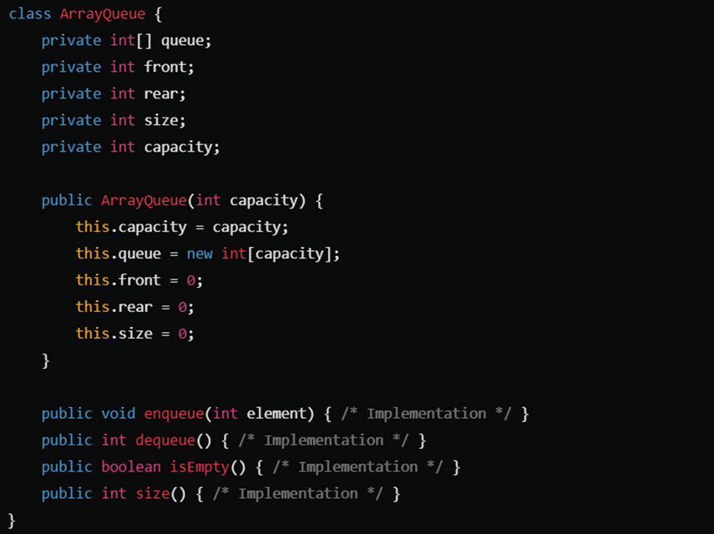
THYNK UNLIMITED
Home
About
Content
Others
EXAMPLE
Key Methods
Enqueue: Add an element to the rear.
Dequeue: Remove an element from the front.
isEmpty: Check if the queue is empty.
size: Return the current number of elements.

Slide 12
THYNK UNLIMITED
Home
About
Content
Others
COMPARE THE
PERFORMANCE OF TWO SORTING ALGORITHMS.
Comparing Sorting Algorithms: Quick Sort vs. Merge Sort
In this comparison we will examine Quick Sort and Merge Sort, two widely used sorting algorithms.

Slide 13
THYNK UNLIMITED
Home
About
Content
Others
COMPARE
INTRODUCTION:
Merge Sort:
QUICK SORT:
.
Quick Sort is a divide-and-conquer algorithm that selects a pivot element and partitions the array into two sub-arrays
Sort is also a divide-and-conquer algorithm that divides the array into halves, recursively sorts each half, and then merges the sorted halves to produce a fully sorted array

Slide 14
THYNK UNLIMITED
Home
About
Content
Others
COMPARE
QUICKSORT TIME COMPLEXITY
BEST CASE
AVERAGE CASE
WORST CASE
O(n²) (when the smallest or largest element is always chosen as the pivot).
: O(n log n) (when the pivot divides the array evenly).
O(n log n).

Slide 15
THYNK UNLIMITED
Home
About
Content
Others
COMPARE
MERGE SORT TIME COMPLEXITY
BEST CASE
AVERAGE CASE
WORST CASE
O(n log n).
: O(n log n)
O(n log n).

Slide 16
THYNK UNLIMITED
Home
About
Content
Others
COMPARE
QUICK SORT SPACE COMPLEXITY
BEST CASE
AVERAGE CASE
WORST CASE
O(n)
: O(log n)
O(log n).

Slide 17
THYNK UNLIMITED
Home
About
Content
Others
COMPARE
MERGE SORT SPACE COMPLEXITY
BEST CASE
AVERAGE CASE
WORST CASE
O(n)
: O(n)
O(n).

Slide 18
THYNK UNLIMITED
Home
About
Content
Others
COMPARE
QUICK,MERGE SORT
QUICK SORT
MERGE SORT
Not stable. Equal elements may not retain their relative order after sorting
Stable. Equal elements retain their relative order after sorting.

Slide 19
THYNK UNLIMITED
Home
About
Content
Others
COMPARE
QUICK,MERGE SORT
QUICK SORT
MERGE SORT
Quick Sort generally performs better in practice due to its smaller constant factors and better cache performance. It's faster for large datasets
Merge Sort guarantees O(n log n) performance, making it more reliable for performance-sensitive applications, particularly when stable sorting is required or when working with linked lists.

Slide 20
THYNK UNLIMITED
Home
About
Content
Others
LET'S GET
SHARED
Ready to transform your business with cutting-edge IT solutions? Contact Thynk Unlimited today to explore how we can help your business thrive.
www.reallygreatsite.com
-
hello@reallygreatsite.com

